Slide 1


MonetDB Column-Oriented DBMS
Lylian Blaud

Slide 2
Summary
Big Data
e-Learning Platform
Row-Oriented DBMS
Column-Oriented DBMS
Optimized Performance
Performance Comparisons between MonetDB and MySQL
Future Work

Slide 3

Big Data

Slide 4

e-Learning
Variety: Different courses
Volume: Data increase all time
Velocity: Need to be faster

Slide 5

e-Learning
Modular Object-Oriented Dynamic Learning Environment (Moodle)
Open source platform
Increasing interest

Slide 6

Cloud Computing
What is Cloud Computing?

Slide 7



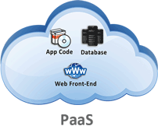
e-Learning
Moodle + Cloud = Cloodle

Slide 8
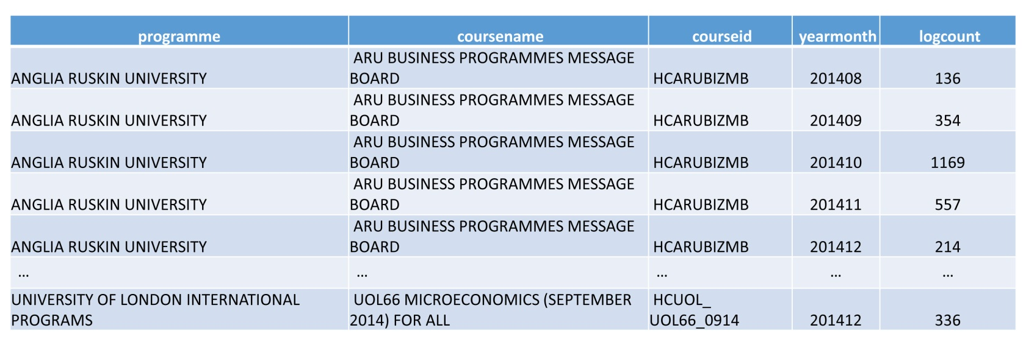
Row-Oriented DBMS
History
The relational model, first proposed in 1970 by Edgar F. Codd
Founded on the notion of relation:
A two-dimensional array containing a set of n-tuples (rows)

Slide 9
Row-Oriented DBMS
What is it?
DBMS Database Management System
Store data in row fashion
High performance writes in Online Transaction Processing (OLTP) applications

Slide 10



Row-Oriented DBMS
id | Name | Post_category | Contain | Date
1 | Lylian Blaud | Status | “Hello !” | 05/19/2015 10:00
2 | Lylian Blaud | Status | “Row-Oriented?” | 05/19/2015 10:01

Slide 11
Row-Oriented DBMS
Serializes all values of a same line together
Row-Oriented Database
7 | CSU Bachelor of information Technology | 10 | 26
8 | UEL BSc Hons Business Information Systems | 10 | 24
9 | CSU Master of information Technology | 23 | 10
Id | Name | Parent | Coursecount
7 | CSU Bachelor of information Technology | 10 | 26
8 | UEL BSc Hons Business Information Systems | 10 | 24
9 | CSU Master of information Technology | 23 | 10

Slide 12

Row-Oriented DBMS
MySQL
Open source RDBMS (Relational Database Management System)
Cross Platforms (Windows, Linux, …)
Row-Oriented DBMS

Slide 13

Column-Oriented DBMS
History
Column stores or transposed files have been implemented from the early days of DBMS development.
Statistics Canada implemented the RAPID system in 1976 and used it for processing and retrieval of the Canadian Census of Population and Housing as well as several other statistical applications.

Slide 14
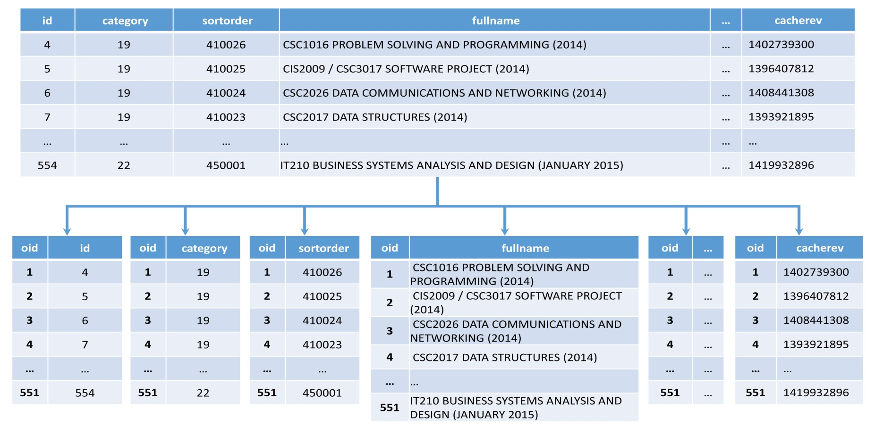
Column-Oriented DBMS
What is it?
Store each column in a table with an oid that can be used for the joins

Slide 15
Column-Oriented DBMS
What is it?
id | Name | Post_category | Contain | Date
1 | Lylian Blaud | Status | “Hello !” | 05/19/2015 10:00
2 | Lylian Blaud | Status | “Row-Oriented?” | 05/19/2015 10:01
oid | id
101 | 1
102 | 2
oid | Name
101 | Lylian Blaud
102 | Lylian Blaud
oid | Contain
101 | "Hello!"
102 | “Row-Oriented?”
…
High performance in Online Analytical Processing (OLAP)

Slide 16

Column-Oriented DBMS
MonetDB
Open source DBMS
Cross Platforms (Windows, Linux, …)
Column-Oriented DBMS

Slide 17
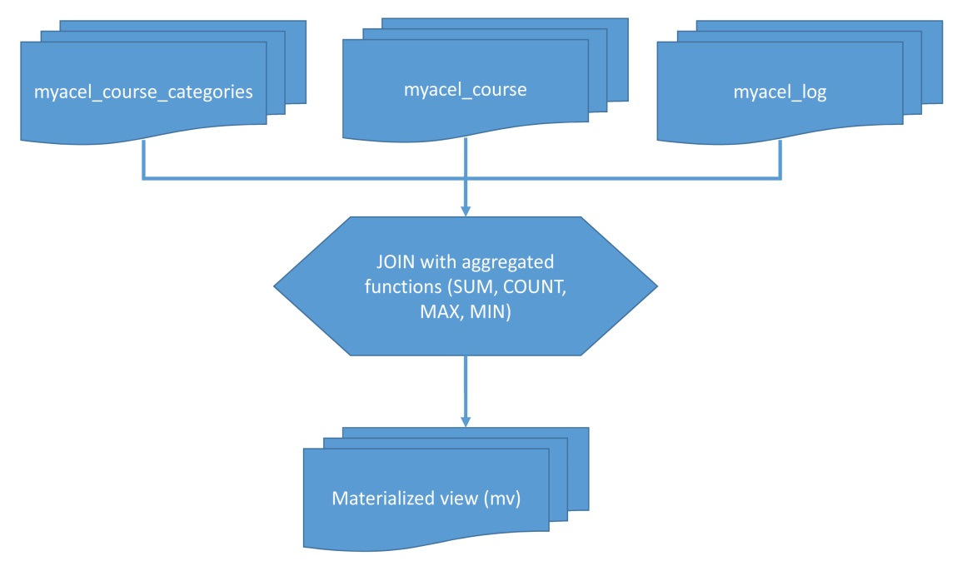
Optimized Performance
Materialized view
Pre-computed data using aggregation functions (such as SUM, COUNT, MIN, MAX)
Massive improvement in query processing time

Slide 18
Optimized Performance
Query rewriting
Use the materialized view for rewrite the same query but more simply
The query rewrite runs faster than the first query
If the query is long, difficult and need to compute, the result return time will be long also

Slide 19
Optimized Performance
Query rewriting
Example:
If the first query Q is “give me the total connection per day” and if we already have evaluated (and stored) the total connection per day per course, the new query Q’ can be rewritten as:
“give me the sum of totals per day per course”
Q and Q’ return the same result but the rewritten query is easier to evaluate because it reuse already stored results

Slide 20
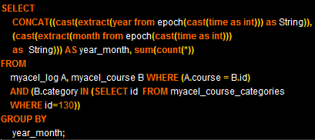
Optimized Performance
Query Rewriting
Example:

Slide 21
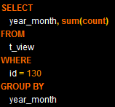
Optimized Performance
Query rewriting
Example:

Slide 22
Environment
Performance comparison between MonetDB and MySQL
For do the test we dispose of one computer with these characteristics:
OS: windows 7
RAM: 4GB
Processor: Quad-Core 2.5GHz
Database : 4GB (5Million rows)

Slide 23
Environment
Database
mdl_log
mdl_course
mdl_course_categories
4.7 million of rows
4000 rows
149 rows
Motivation: We must compare MySQL and MonetDB for find what is the faster without the optimization performance in the first time and with in the second part.

Slide 24
Comparison
Performance Comparison between MonetDB and MySQL
The query is:
Give me the number of unique e-Learning sign on between the 2014/01/01 and 2015/01/01 per hour
The result return time without optimized performance:
DBMS | MonetDB | MySQL
Time (s) | 26.66 | 93.676
MonetDB:

Slide 25
Comparison
Performance comparison between MonetDB and MySQL
The result return time with optimized performance:
DBMS | MonetDB | MySQL
Time (s) | 5.11 | 10.46

Slide 26
Result Discussion
We saw a significant difference between MonetDB and MySQL with the optimize performance in the result return time.
OP : Optimized Performance

Slide 27
Future work
Try a hybrid storage model with mediator based prototype
Client
SQL Query
Registry
Mediator
Row DB
Column DB

Slide 28
Conclusion
With the result and the future works we can conclude that we can have the choice and the test with the hybrid storage model can be really important and can improve the result return time and the choice between row and column oriented

Slide 29
Glossary
Keyword
-4Vs (Volume, Variety, Velocity, Veracity)
-Cloud Computing
-DBMS (DataBase Management System)
-Cross Platform
-Column-Oriented DBMS
-Row-Oriented DBMS
-Hybrid Storage
Thank you for your attention
Any question?

